Slide 1
Covid Data Dashboard
File created on: 8/16/2021 6:15:16 PM

Slide 2


Slide 3
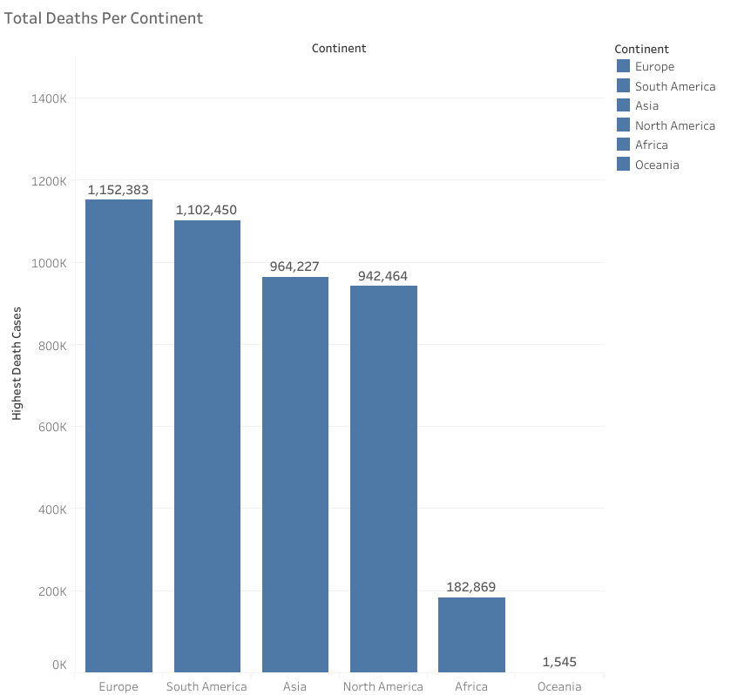

Slide 4
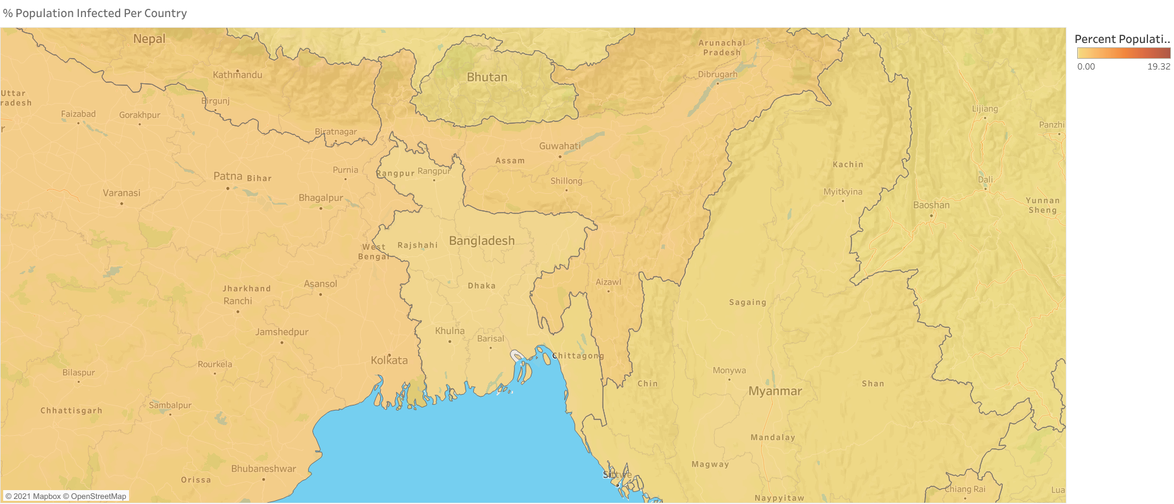

Slide 5
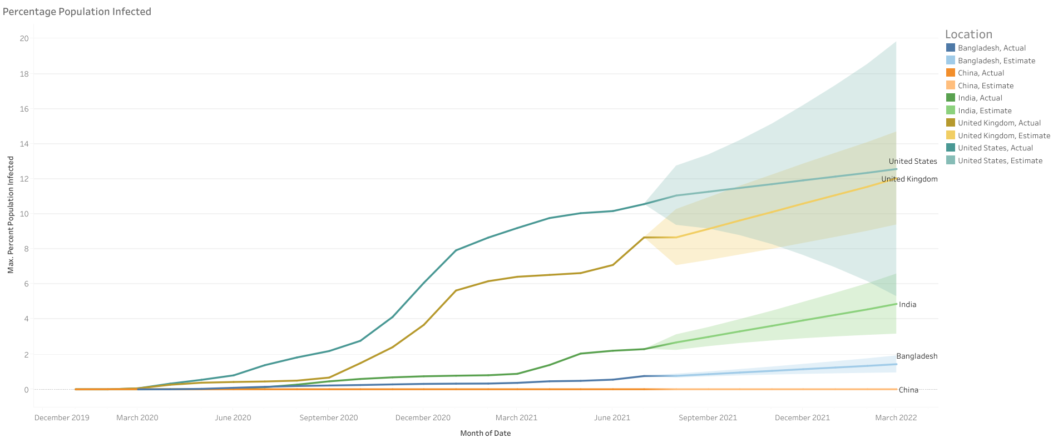

Slide 6
